Slide 1

Chapter 1 ~ Introduction to Digital Image Processing
Created By
S. M. Mahedy Hasan Assistant Professor, Dept. of CSE RUET, Rajshahi-6204, Bangladesh.
Modified by
Md. Manirujjaman
Lecturer, Dept. of CSE
DIU, Satarkul, Badda, Dhaka

Slide 2
Digital Image Processing
Digital
Image
Processing
  Processing of an image which is digital in nature, by a digital computer.
Motivation…………..
Improvement of pictorial information.
Efficient storage and transmission.

Slide 3
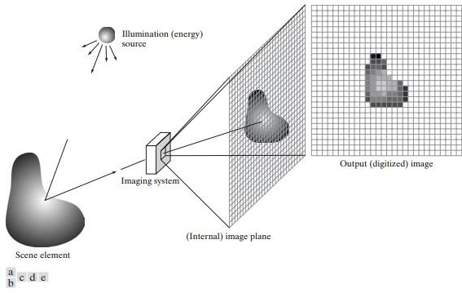
What is an Image?
Projection of 3D scene in a 2D plane is noting but an image.
Figure: An example of the digital image acquisition process. (a) Energy (“illumination”) source. (b) An element of a scene. (c) Imaging system. (d) Projection of the scene onto the image plane. (e) Digitized image.

Slide 4

What is an Image?
Image is a representation of something or someone. Examples are drawing, painting and
photograph etc.
It may be black and white or color.
Figure 1: Black and white
Figure 2: Color image

Slide 5
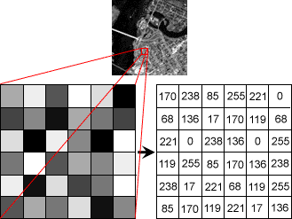
Digital Image
Digital Image represents as-
  A two dimensional function f(x,y).
  Where, x and y are spatial coordinates.
  The amplitude of f at any pair of coordinates (x,y) is called intensity or gray level.
  When x, y and f(x,y) all are finite and discrete quantities, we can call the image as a digital image.
  Digital image is composed of a finite number of elements, each of which has
a particular location and value. These elements are referred to as-
i. Picture Elements
ii. iii. iv.
image Elements
Pels
Pixels
Figure 3: Digital image

Slide 6
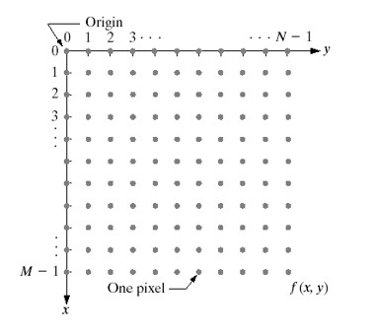
Digital Image(Cont’d)
Digital Image can also be represented as M
rows and N columns.
Each pixel is represented by K bits.
A pixel can thus have 2^{𝐾}different values.
Figure 4: Row and column representation of digital image

Slide 7
Pixel
The full form of the pixel is "Picture Element." It is also known as "PEL." Pixel is the smallest
element of an image on a computer display, whether they are LCD or CRT monitors.
Below is the formula to calculate the total number of pixel in an image.

Slide 8
Gray Level
The value of the minimum gray level is 0. The gray level depends on the depth of the image.
For example: In an 8-bit image, gray level is 255. For a binary image, a pixel can only take value
0 or 255. In color image, it can choose values between 0 and 255.

Slide 9
Bits Per Pixel
BPP or Bits per Pixel is used to denote the number of bits per pixel and the number depends on
the depth of color.
Image size: The size of an image depends on three things they are as following :
Number of rows
Number of columns
Number of bits per pixel

Slide 10
Image Processing
Image processing is a method to convert an image into digital form and perform some operations on it, in order to get an enhanced image or to extract some useful information from it.
It is a type of signal dispensation in which input is an image, and output may be image or characteristics associated with that image.
Image processing basically includes the following three steps-
  Importing the image via some image acquisition tool.
  Analyzing and manipulating the image.
  Output is the last stage in which result can be altered image or report that is based on image analysis.

Slide 11
Purpose of Image Processing
The purpose of image processing can be divided in to 5 groups-
Visualization- Observe the objects that are not visible.
Image sharpening and restoration- To create better image.
Image retrieval- Seek for the image of interest.
Measurement of pattern- Measures various objects in an image.
Image recognition- Distinguish the objects in an image.

Slide 12
Level of Processing in DIP
The continuum from image processing to computer vision can be broken up into low-, mid- and
high-level processes.
Low Level Process
Mid Level Process
High Level Process
Input: Image
Output: Image
Examples: Noise removal, image sharpening
Input: Image
Output: Attributes
Examples: Object recognition, segmentation
Input: Attributes
Output: Understanding
Examples: Scene understanding, autonomous navigation
In this course we will stop here

Slide 13
Image Processing Environment
Object
Self Luminous Object
Sensor
Radiation
Source
Transmissive
Object

Slide 14
Types of Imaging
There are three types of based on different objects:
Reflective Mode Imaging
Emissive Type Imaging
Transmissive Type Imaging

Slide 15
Reflective Mode Imaging
It is the simplest form of imaging.
It uses a sensor to acquire the digital image.
All video cameras, digital cameras, and scanners use some type of sensors to capture the image.

Slide 16
Emissive Type Imaging
Images are acquired from self luminous objects without the help of a radiation source.
In this type of imaging the objects are self luminous.
The radiation emitted by the object is directly captured by the sensor to form an image.
Thermal imaging (Magnetic Resonance Imaging) is an example of emissive type imaging.

Slide 17
Transmissive Type Imaging
The radiation source illuminates the object.
The absorption of radiation by the objects depends upon the nature of the material.
Some of the radiation passes through the objects.
The attenuated radiation sensed to an image.
Examples are X-Ray imaging, ultrasound imaging, microscopic imaging etc.

Slide 18
Challenges in Image Processing
The first major challenge in image processing is to acquire
the image for further processing.
Three types of processing are there:
Optical image processing: It is the study of radiation source, the object and the other optical processes involved.
Analog image processing: It is an area that deals with the processing of analog electrical signals using analog circuits.
Digital image processing: It is an area that uses digital circuits, systems, software algorithms to carry out the image processing tasks.

Slide 19
Image Processing and Related Fields
Optics
Graphics
Statistics
Image Processing
Computer Vision
Video Processing
Artificial Intelligence

Slide 20
Elements of Digital Image Processing Systems
Storage
Optical disks
Magnetic tape
Hard disk
Image acquisition
equipment
Scanner
Camera
Sensor
Processing Unit
Computer
Workstation
Display Unit
Monitor
Projectors
Printer
Communication Channel

Slide 21
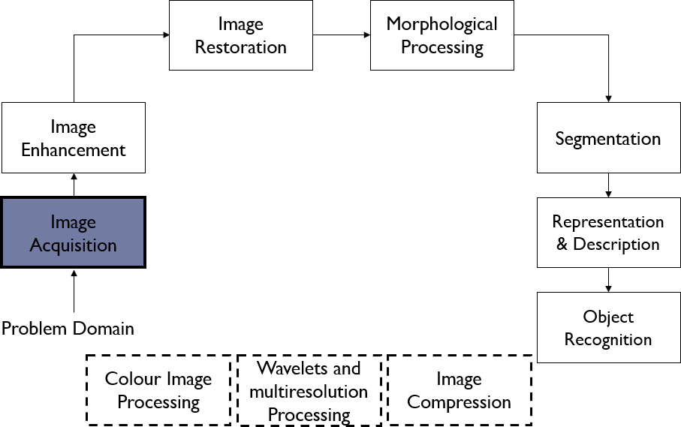
Fundamental Steps in Digital Image Processing
Figure 5: Steps of digital image processing

Slide 22
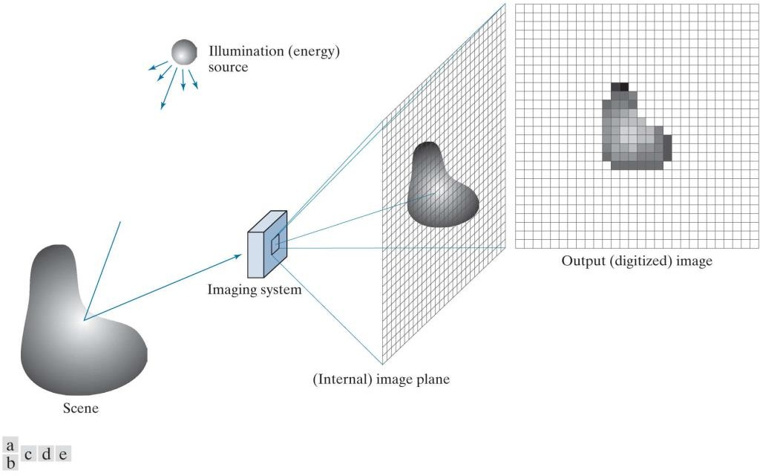
Image Acquisition
Generally, the image acquisition stage involves preprocessing, such as scaling.
Figure 6: An example of digital image acquisition. (a) Illumination (energy) source. (b) A scene. (c) Imaging system. (d) Projection of the scene onto the image plane. (e) Digitized image.

Slide 23
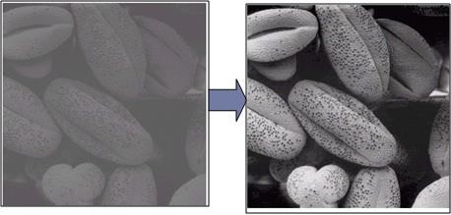
Image Enhancement
Image enhancement is the process of manipulating an image so that the result is more suitable than the original for a specific application.
It involves brightness, contrast etc.
Figure 7: Image enhancement

Slide 24
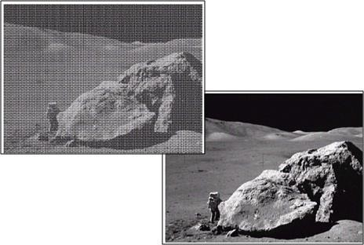
Image Restoration
Image restoration is an area that also deals with improving the appearance of an image.
Unlike enhancement, which is subjective, image restoration is objective, in the sense that restoration techniques tend to be based on mathematical or probabilistic models of image degradation.
It takes a corrupt/noisy image.
Enhancement, on the other hand, is based on human subjective preferences regarding what constitutes a "good" enhancement result.
Figure 7: Image restoration

Slide 25
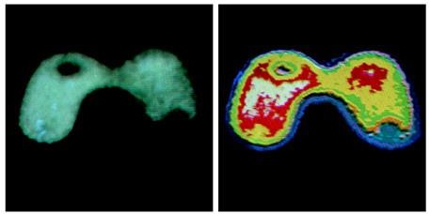
Color Image Processing
Color image processing is an area that has been gaining in importance because of the significant
increase in the use of digital images over the Internet.
Figure 8: Color image processing

Slide 26

Morphological Processing
Morphological processing deals with tools for extracting image components that are useful in
the representation and description of shape.
Figure 9: Morphological processing

Slide 27
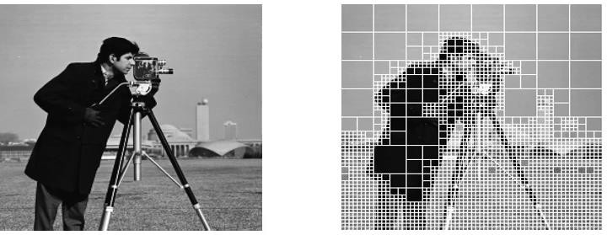
Segmentation
Segmentation procedures partition an image into its constituent parts or objects.
Figure 10: Image segmentation

Slide 28
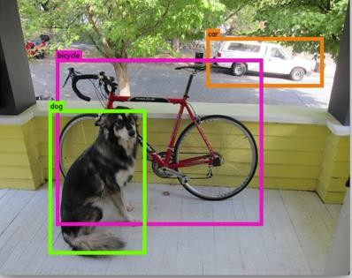
Object Recognition
Recognition is the process that assigns a label (e.g., "vehicle") to an object based on its
descriptors.
Figure 11: Object recognition

Slide 29
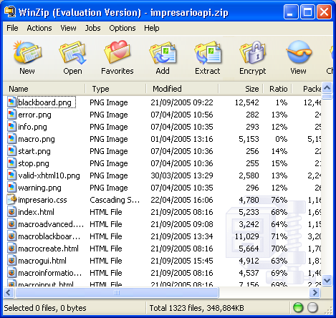
Image Compression
Compression, as the name implies, deals with techniques for reducing the storage required to save an image, or the bandwidth required to transmit it.
Figure 14: Image compression

Slide 30
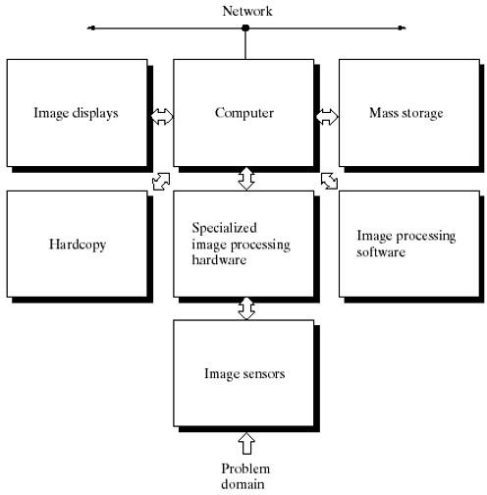
Components of an Image Processing System
Figure 15: Components of image processing system

Slide 31
Image Types
Image
Attributes
Color
Dimension
Raster
Binary
2D
Vector
Gray
scale
3D
True color
Pseudo color

Slide 32
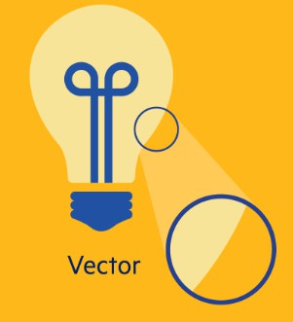
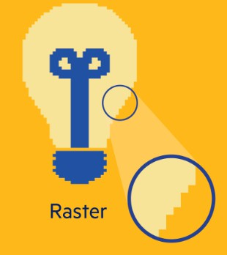
Types of Images based on Attributes
Raster Images are pixel based. The quality of
the raster images depend on number of pixels.
Vector Graphics use geometric attributes like
lines and circles to describe an image.

Slide 33
Types of Images based on Color
Binary Images are also called bi-level images. The pixel assume a value of 0 and 1.
Grey level Images Eight bits (2^8=256) are enough to represent grey scale as human visual system can distinguish only 32 different levels. A gray scale image is a kind of black and white or gray monochrome are composed exclusively of shades of gray.
True Color Images Also known as full color images represents the full range of available colors. Mostly they use 24 bits to represent all the colors. Hence, they can be considered as three band images.
Pseudo Color Images These are false color images, where colors are added artificially based on the interpretation of data. They are popular in medical domain. Doppler color images are the example of pseudo color images.

Slide 34
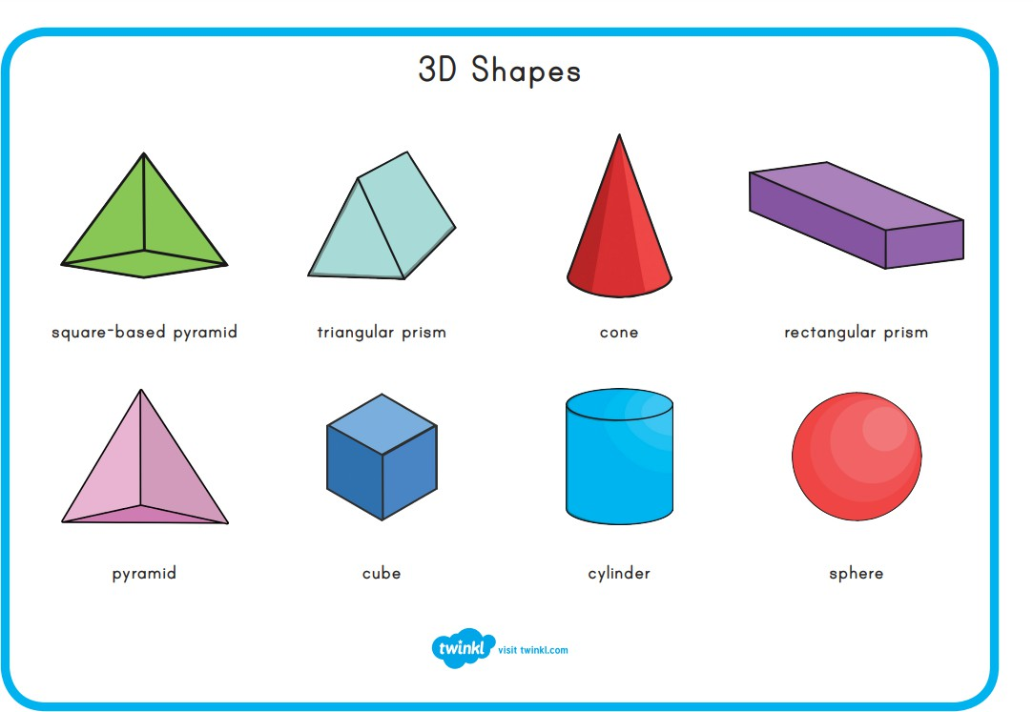
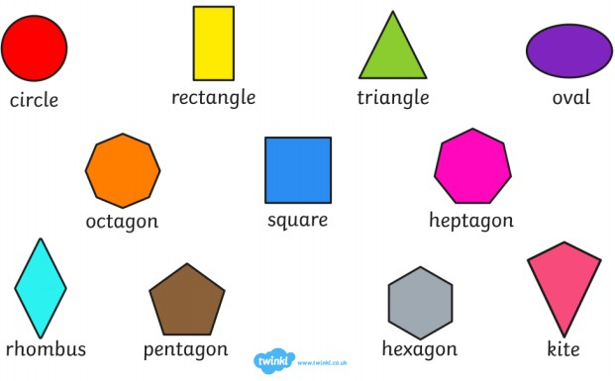
Types of Images based on Dimensions
Generally digital images are 2D rectangular array of pixels.
If another dimensions are added like depth or any other characteristics, it is necessary to use
higher order stack of images like 3D.

Slide 35
Image Formats
JPEG: This is known for Join Photographic Expert Group. JPEGs are known for their "lossy" compression, meaning that the quality of the image decreases as the file size decreases. JPEG files are very common on the Internet and JPEG is a popular format for digital cameras - making it ideal for web use and non-professional prints.
GIF: This is known as Graphics Interchange Format (Lossless compression). In their more basic form, GIFs are formed from up to 256 colors in the RGB color-space.
BMP: This is known as Bit Map Picture. BMP or Bitmap Image File is a format developed by Microsoft for Windows. There is no compression or information loss with BMP files which allow images to have very high quality, but also very large file sizes.

Slide 36
Image Formats
TIFF: TIFF or Tagged Image File Format are lossless images files meaning that they do not need to compress or lose any image quality or information (although there are options for compression), allowing for very high-quality images but also larger file sizes. Compression: Lossless - no compression. Very high-quality images. Best For: High quality prints, professional publications, archival copies.
PNG: PNG or Portable Network Graphics files are a lossless image format originally designed to improve upon and replace the gif format. PNG files are able to handle up to 16 million colors, unlike the 256 colors supported by GIF. Compression: Lossless - compression without loss of quality Best For: Web Images.
EPS: An EPS or Encapsulated PostScript file is a common vector file type. EPS files can be opened in many illustration applications such as Adobe Illustrator or CorelDRAW. Compression: None - uses vector information Best For: Vector artwork, illustrations

Slide 37
Thank You ☺

